Slide 1
Mobile development options Hybrid app development
Oleksandr Mykhaylyshyn
July, 2014

Slide 2
Agenda
Mobile development options
Ways to go
Key considerations
Popular frameworks
Hybrid application development
Challenges and drivers
Hybrid “Mixed” solution
Look at Mobile client architecture
Pitfalls

Slide 3
Mobile app development options
How to choose ?

Slide 4

I need a Mobile app…

Slide 5
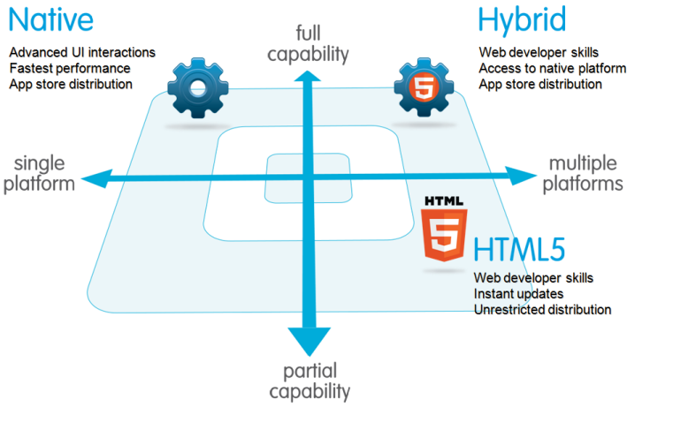
“Going mobile”. Ways to go
I know everyone has seen this picture before ☺

Slide 6
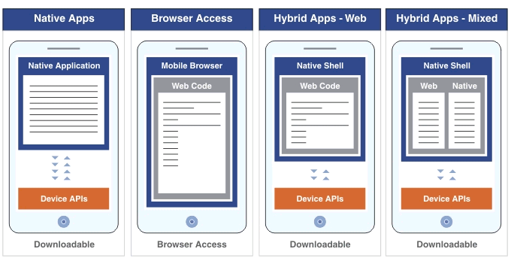

Ways to go: Look closer
Notes:
Native
Web
Almost 2014 year out of the window. If you’re new to mobile app development, you’re late to the party.
However, for mobile Web-based apps, there are still partying like it’s 1999!
Device agnostic
Hybrid
Server – load web content from a remote server
Local – embed web content into native app itself
Hybrid+
The same as Hybrid + native screens

Slide 7
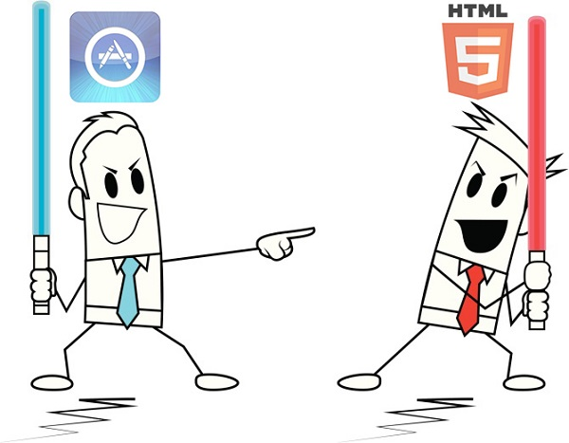
Focus on the right question
Notes:
If “native apps vs. mobile sites” is not the most relevant question, then what is?
you need to focus on the products, services, and audiences for which you are building.
Next, you should detail objectives and focus on the budget, resources, and timeline. You need to focus on Key Considerations.
When all this is clear, you can move on to the architectural side of the project.
At that point, you will probably discover that you have just one option left.

Slide 8
Key considerations
Development speed and COST
Available programming expertize
UX: Design, Responsiveness, Performance
Data persistence & security
Access to native device functionality
Toolset maturity
Cross platform support
Device fragmentation challenges
Timely access to new OS innovations
Deployment: updates and distribution control
Notes:
Dev Speed and Cost: Hybrid apps are faster to develop. Only a portion of native code has to be re-written for different kinds of devices.
Available programming expertize: It’s easier to find web developers
Data Persistance & security:
- You can write web offline app (localStorage, webSql, indexedDb). Frameworks like JayData…
- HTML5 app cache
- web is less secured
Device functionality:
- http://phonegap.com/about/feature
- http://mobilehtml5.org
Toolset maturity:
- native toolset is rich!
- web toolset is growing
- it’s hard to troubleshoot hybrid apps
Device fragmentation challenges:
- form factor
- different versions of OS
FROM http://www.appcelerator.com.s3.amazonaws.com/pdf/appcelerator-whitepaper-native-html5.pdf
1. User experience
2. Performance
3. Monetization
4. Cross platform deployment costs
5. Fragmentation
6. Availability of programming expertise
7. Importance of immediate updates
and distribution control
8. Timeliness of new OS innovations
9. Security

Slide 9
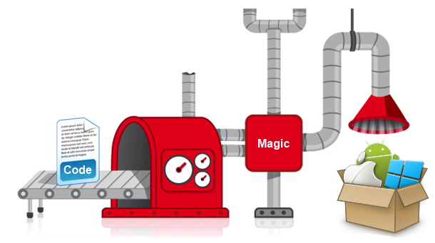
Write once – user everywhere

Slide 10
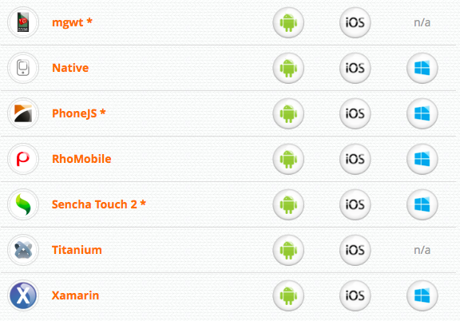
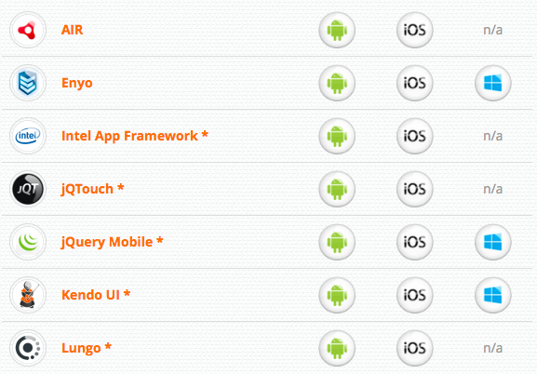
PropertyCross: non trivial examples
Notes:
It’s IMPORTANT to have UX design when you’re intended to choose a framework !!!
Learning Curve
Do your developers like this framework ?

Slide 11
Case Study
Does “Hybrid” means PhoneGap ?
Notes:
Moving on let’s take a look some case studies

Slide 12
Challenges and architecture drivers
Port complex legacy solution to desktop
Cross-platform support
Offline capability
Security
Available skillset
Time to market
Notes:
1) Huge desktop app developed on Delphi
2) iOS First; Then Android and Windows. GET maximum value from investment! – Desktop !!!
3) Domain model – around 200 tables ! Browser storages are not so mature.
4) Data encryption is important for Healthcare!
5) .Net and Delphi developers with Web skills.
6) Stay competitive ! – Distributed Agile

Slide 13



Client side Modularity: Hybrid “Mixed” Approach
…
SPA
Module 5
SPA
Module 6
Module 7
Module 8
SPA
Module 9
Notes:
For such a big solution we used Hybrid “Mixed” approach on a client side.
- The primary point is to develop all modules in HTML5 to get as much as possible reusable code
- At the same time we left “door opened” to be able to develop UI rich and complex modules as a Native in order to achieve the best User Experience and performance on a tablet device
- Actually an initial reason we used Hybrid development instead of Mobile web is a Security that is always important for Healthcare industry. Since the app has full offline support we used local database embedded in “native shell”

Slide 14
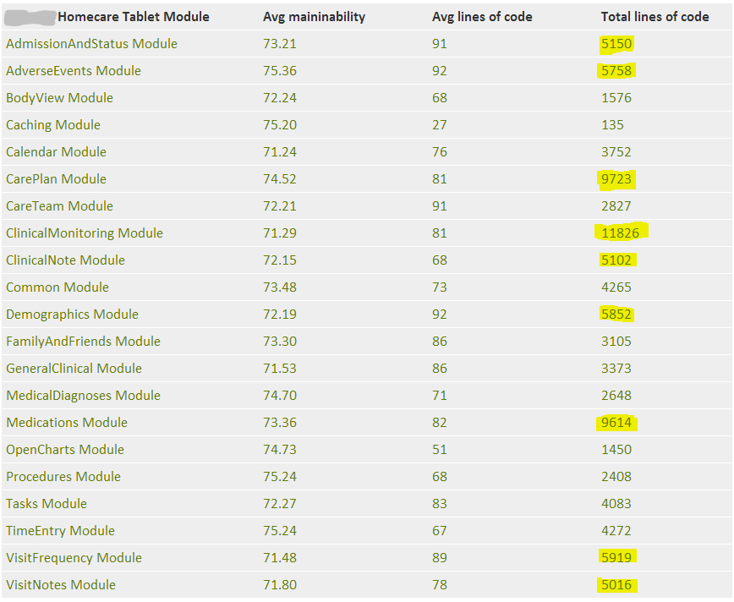
Just to understand actual size

Slide 15
Client native/web UI components
Header
Web module (Index.html)
Navigation
menu
Native module
Footer

Slide 16
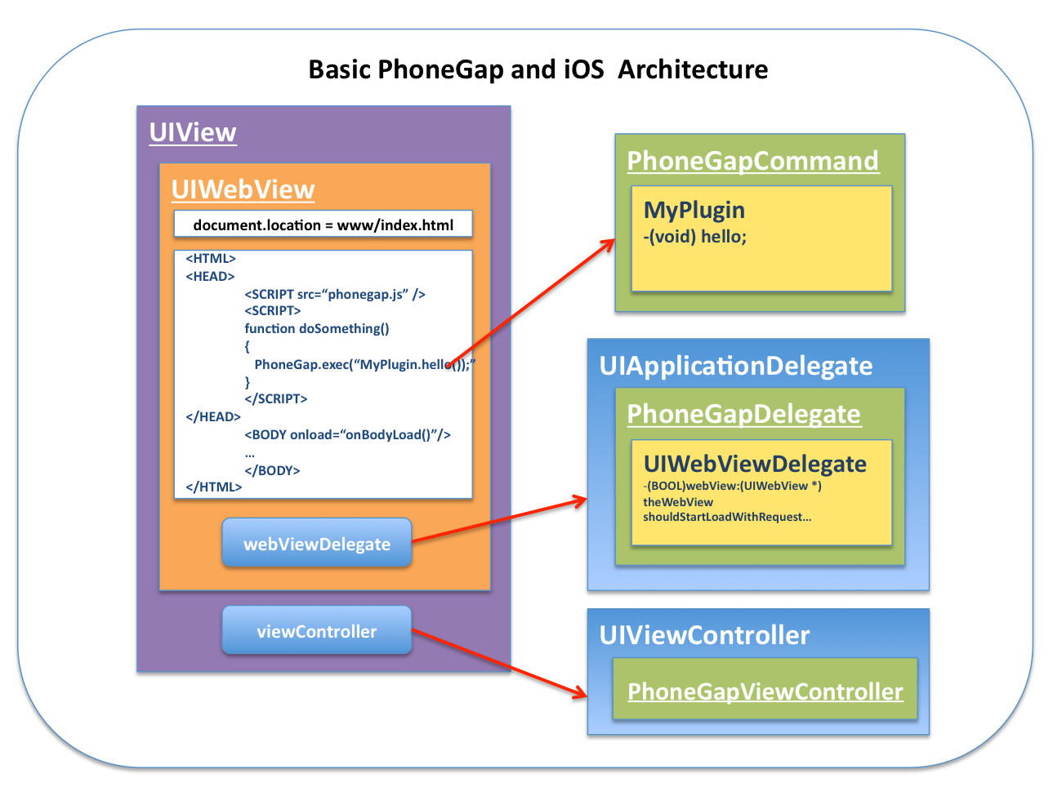
JavaScript and Native. How to communicate ?
Notes:
We need to pass bunch of data!
Call methods on both sides !
Speed was definitely a concern. Delivering a message over the URL scheme bridge could consume over 100 ms. Aside from that, however, we faced two major issues:
Sending too many messages, too quickly, would cause unpredictable behavior.
What was happening was that if the first URL navigation wasn't completed before the second one was sent, the first would be canceled before it reached native, and we would only receive the second message. In short, we were losing messages.
After sending a message, it would often seem like our UIWebView had died. It would no longer render new views and generally exhibited odd behavior.Once an HTML document attempts navigation in iOS, iOS assumes that the document is no longer required, and thus disabled certain functionality such as innerHTML setting and timers. Thankfully,Alexandre Poirot had already run into and posted a solution for this issue — performing the navigation in an iFrame.

Slide 17
Hybrid client: architecture
Native Shell
Server API
Navigation
Plugin Host
Context Sharing
Native Module
Web Module
http://localhost:9999/go
SSO
HTTP server
…
Data access
Synch
SQLite
Notes:
Grey – native staff
The app can host other native applications and web modules

Slide 18
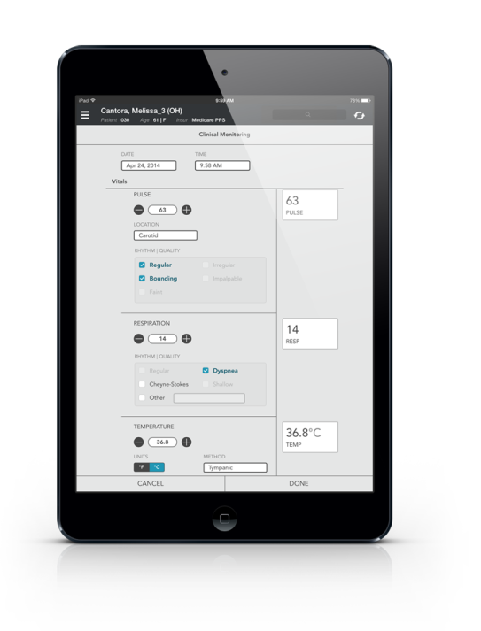
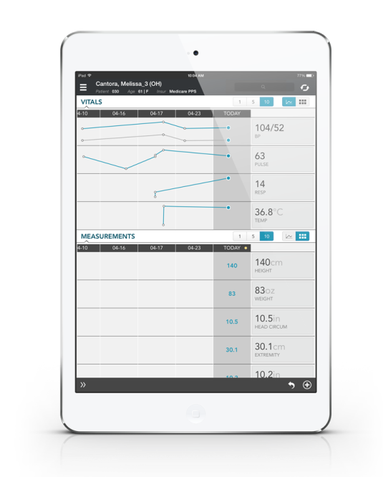
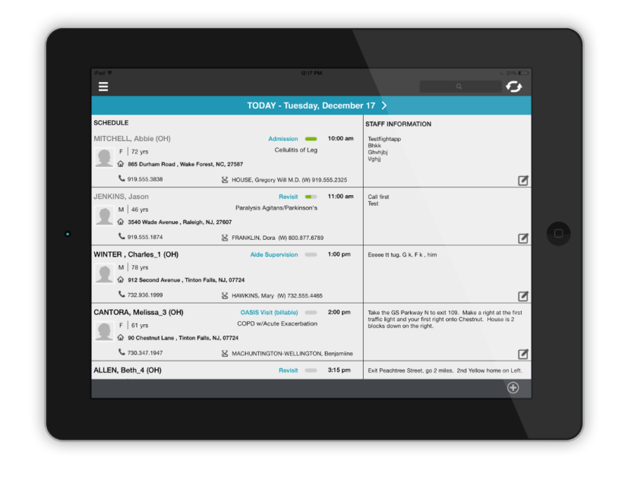
Homecare Tablet Solution: Screenshots
Notes:
Web based Modules
Clinical Monitoring data entry on the left
Clinical Monitoring Summary page with charts and tables built based on historical and just entered data
My Day module represents a schedule of visits for today and future dates

Slide 19
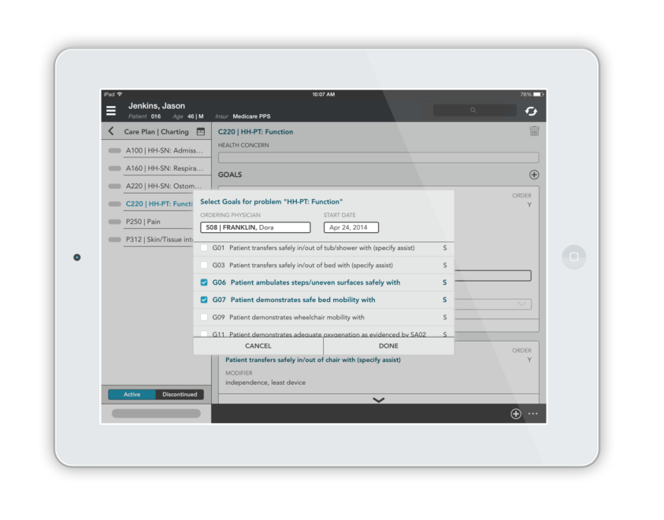
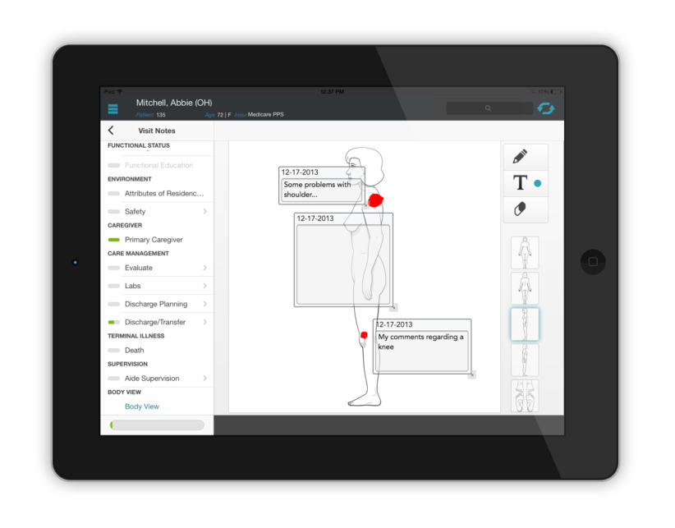
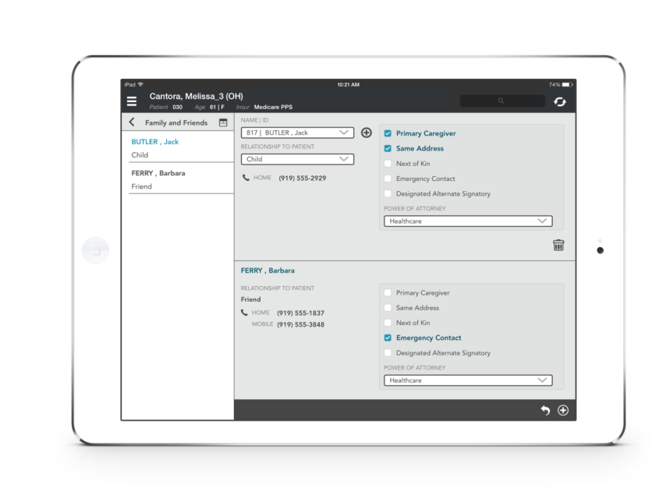
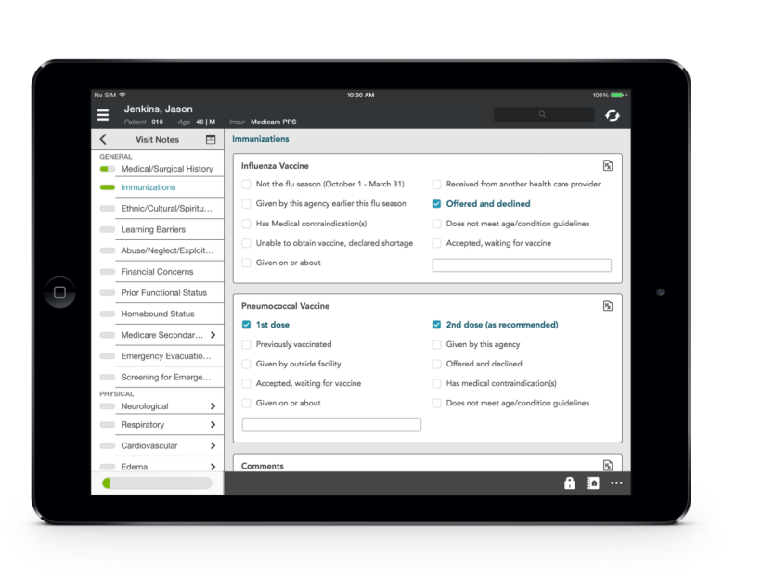
Homecare Tablet Solution: Screenshots
Notes:
This is another module called “Body View”.
It requires more user interaction and to mitigate the risk with performance it’s developed in Native code.
Module representing Family Friends (Web)
(Web) module for Care planning and charting
Another module is related to assessments.
As you can see there is no visual difference between Web and Native modules.

Slide 20
Pitfalls
Let stakeholders know that web != native
UI/Development framework selection
Stay on the same page with your UI team
You will need HTML/CSS expert
Be ready to code duplication
Complex troubleshooting
Notes:
Learning Curve
Do your developers like this framework ?
It’s risky to say “Hi, this framework is really what you need!”

Slide 21
Thank You

